Slide 1


FUFO Project
Final Report

Slide 2

Contents
1
Introduction
2
Hardware & Software
3
Algorithms
4
Experiments and results
5
Conclusion

Slide 3
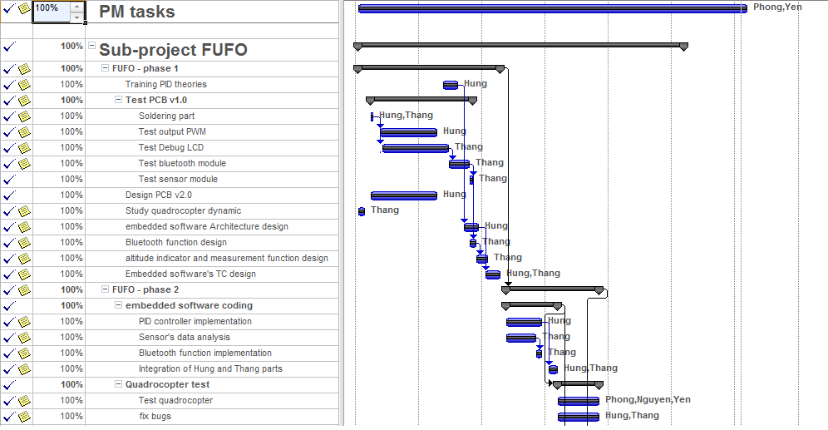
Project Plan
Introduction

Slide 4
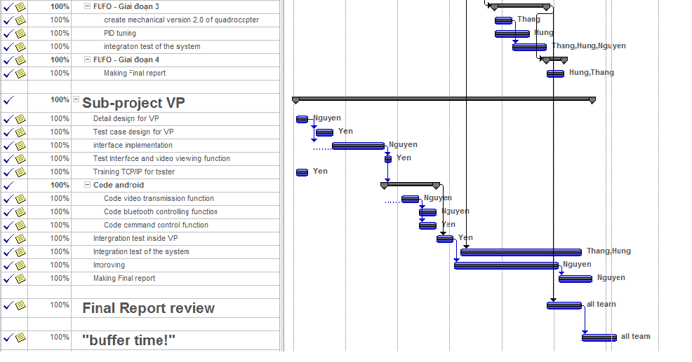
Project Plan
Introduction

Slide 5
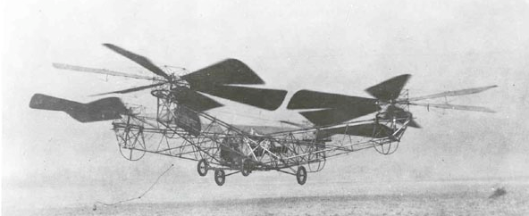
History
Introduction
The first Quadrocopter was developed in 1920.
No commercialized Quadrocopter because of limitation of technology and science at that time.

Slide 6
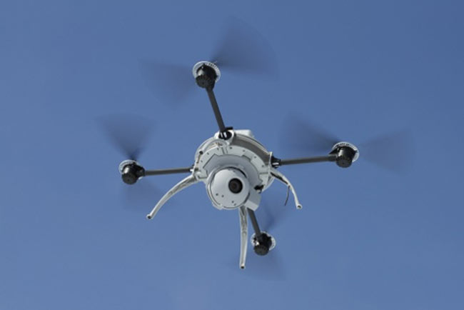
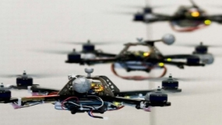
History
Introduction
8 years before 2012, many institutes and companies began to research on this platform as a small UAV.

Slide 7
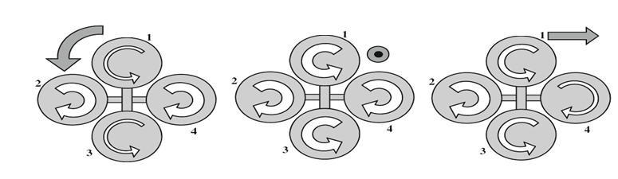
Quadrocopter
Introduction
Definition:
A Vertical Take-Off and Landing (VTOL) aircraft*.
Has 4 rotors.
*Anderson, S.B. (March). "Historical Overview of V/STOL Aircraft Technology". NASA Technical Memorandum 81280

Slide 8
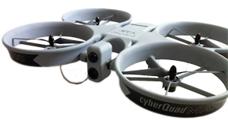
Commercialized product
Introduction
Airbot X600-BKPP (€ 34,500)
Radio control unit (2.4 GHz)
Live video stream
GPS waypoint navigation
CyberQuad Maxi ($ 36,000)
Radio control unit
GPS waypoint navigation
Live video stream

Slide 9
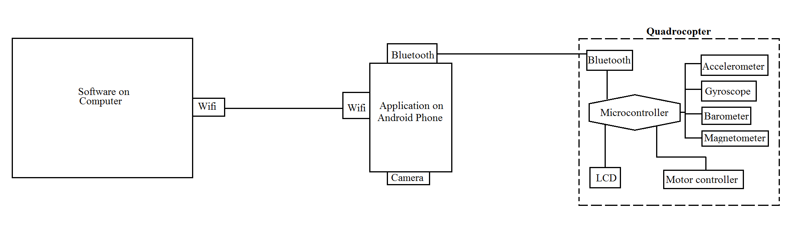
Idea
Introduction
Develop a Quadrocopter for observation purpose.
Make the system simpler.

Slide 10
Idea
Introduction
Why choosing Quadrocopter platform?
 | Quadrocopter | Helicopter** | Fixed-Wing aircraft*
Aerodynamics mechanical design | Medium | Complicated | Complicated
Control method | Medium | Medium | Complicated
Runway | No | No | Yes
➔ Quadrocopter is more suitable for embedded Engineering students who are not familiar with aerospace issue and mechanical design.
*: http://en.wikipedia.org/wiki/Fixed-wing_aircraft
**: http://en.wikipedia.org/wiki/Helicopter

Slide 11
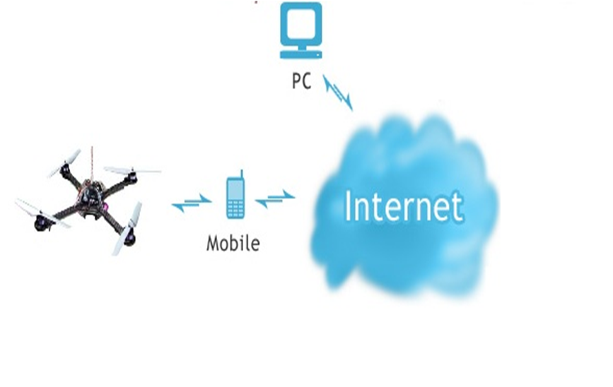
Idea
Introduction
Command
Sensor data
Bluetooth

Slide 12
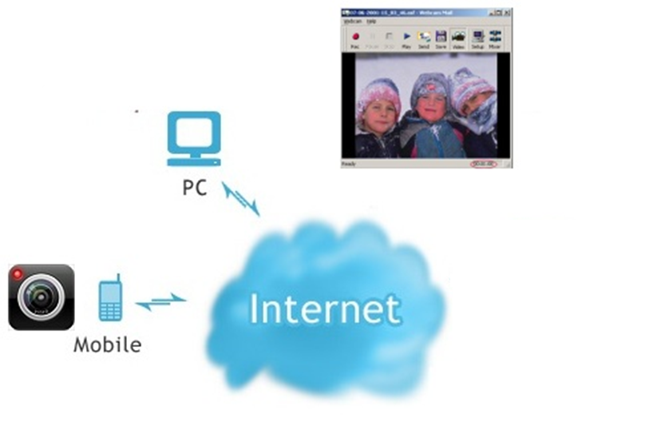
Idea
Introduction
Picture
Picture
JPEG
JPEG

Slide 13
Idea
Introduction
Control Mode
Autonomous(Dynamic Stabilization)
Manual

Slide 14
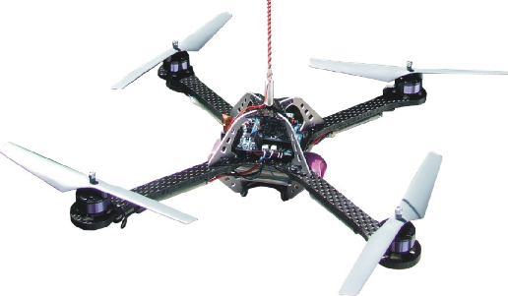
Idea
Introduction
Wind
Manual mode

Slide 15
Idea
Introduction
Dynamic stabilization
Wind
Dynamic Stablization
SAFE
Go to 1m

Slide 16
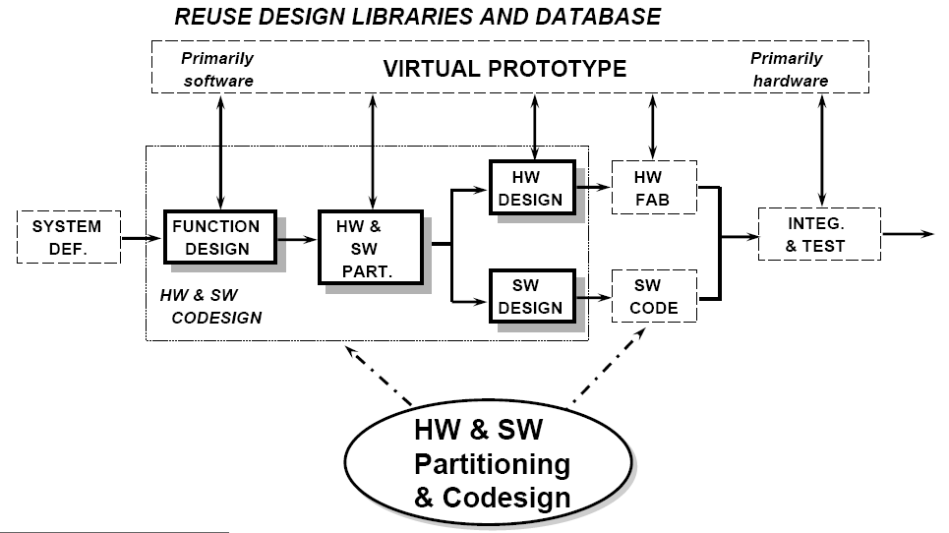
Development model
Hard & Soft
Embedded system development:

Slide 17
Risks
Hard & Soft
A
M
P
Time
Cost
S
Mechanic and PCB
Assert & evaluate algorithm
Hardware equipments
Unstable Environment
Copyright software
Studying new areas
Potential cost
Accident and damage
Testing
Tools
U
A
C
H
Notes:
Note: Cần giải thích kỹ hơn từng keyword khi thuyết trinh

Slide 18
Hardware study
Hard & Soft
No. | Components | Quantity | Description
1 | dsPIC30f4012 | 1 | Microcontroller
2 | HC-06 | 1 | Bluetooth module
3 | BMP085 | 1 | Barometer
4 | L3G4200D | 1 | Gyroscope
5 | ADXL345 | 1 | Accelerometer
6 | HW 30A ESC | 4 | Electronic speed Controller
7 | Himodel 2212 1400kv | 4 | Brushless motor
8 | Turnigy 3000mAh 11.1v 3s | 2 | Li-Po battery pack.
9 | HTC HD2 | 1 | Android 2.3 phone

Slide 19
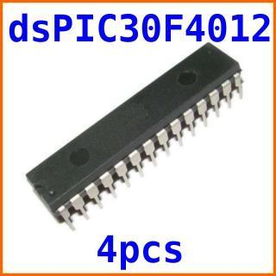
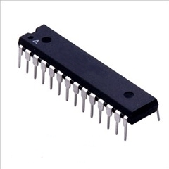
Hardware study
Hard & Soft
dsPIC30f4012 Microcontroller
Max speed: 30 MIPS
16x16 bit working arrays
5 timers, 3 PWM generators
Programmable by C30.

Slide 20
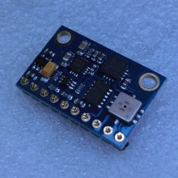
Hardware study
Hard & Soft
BMP085 + ADX345 + L3G4200D
All-in-one module:
3-axis accelerometer.
3-axis gyroscope.
Barometer: -300m to 9000m measureable.

Slide 21
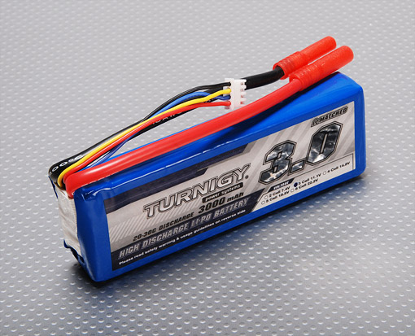
Hardware study
Hard & Soft
Turnigy 3000mAh battery pack
3000mAh x 2
253 grams x 2
11.1v
Current rate: 20C

Slide 22
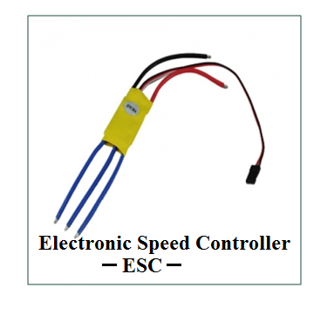
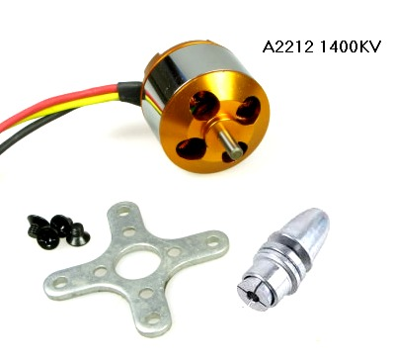
Hardware study
Hard & Soft
Motor and ESC:

Slide 23
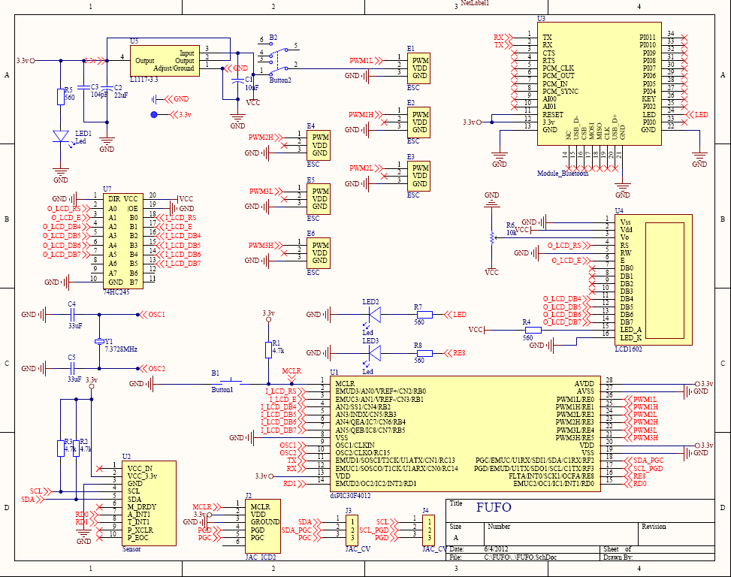
Hardware design
Hard & Soft
Bluetooth
ESC
LCD
MicroController
Sensors

Slide 24
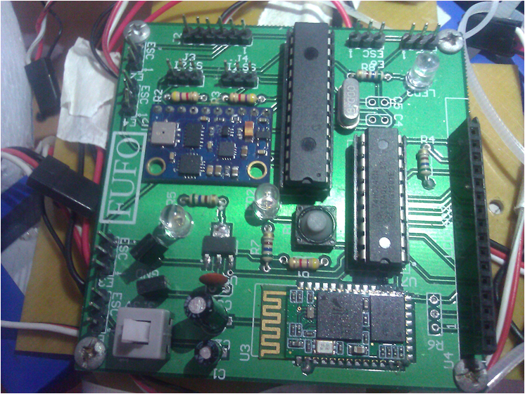
Hardware design
Hard & Soft
MicroController
ESC
LCD
Sensors
ESC
Bluetooth

Slide 25
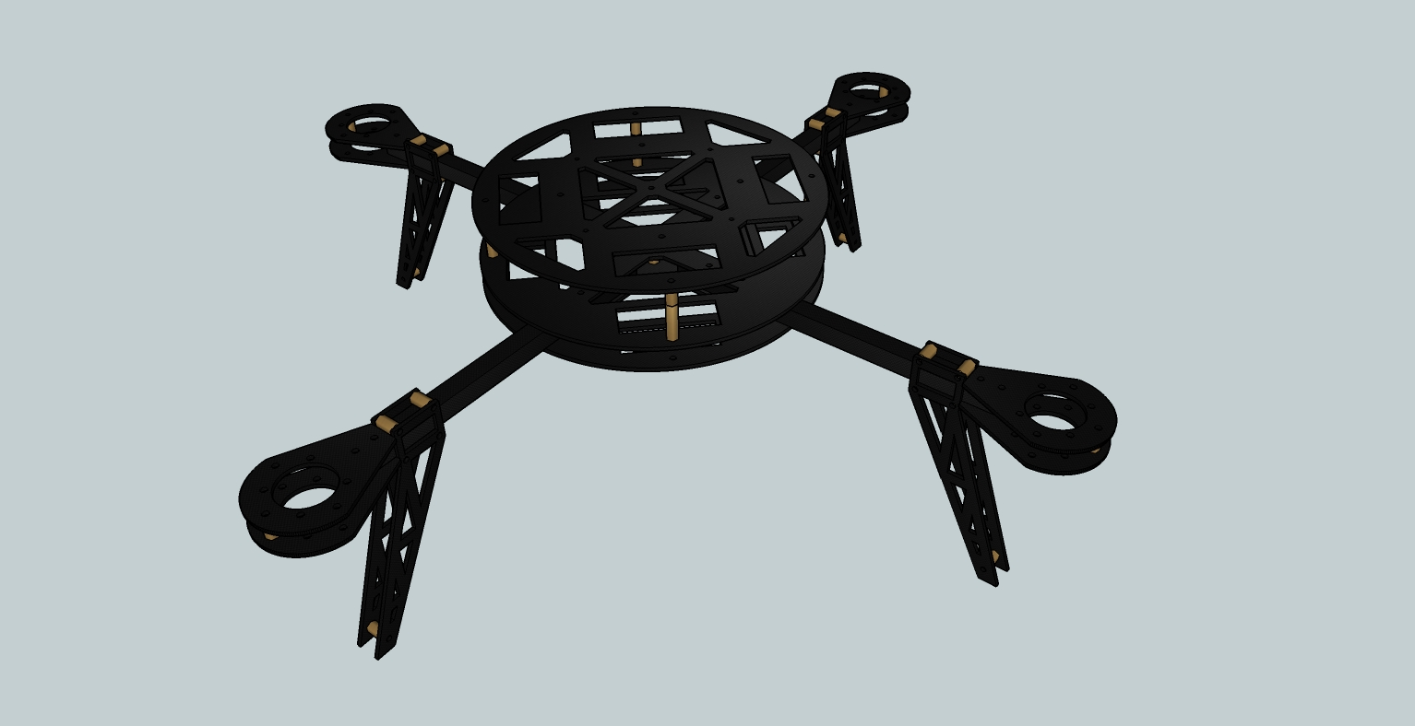
Frame design
Hard & Soft
Circuit mount
440 mm
Motor mount
Fiber Glass & Fiber Carbon

Slide 26
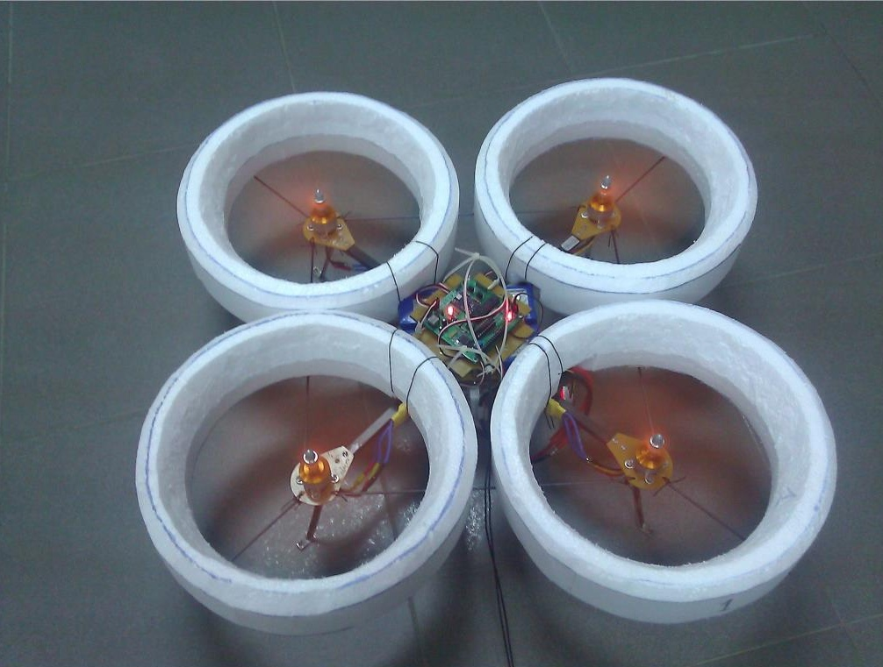
FUFO Quadrocopter
Hard & Soft

Slide 27
Software study
Hard & Soft
Three software:
Software on PC
Software on Phone
Firmware

Slide 28
Software study
Hard & Soft
FSM:
System initiated
System connected
WaitingForConnection
Start
Verify
Power on
Control
method
selected
Sensor data
initiated
Start button
pressed
Ready
SetupForFlight
Pending
First altitude
is chosen
Any error
Hovering
Error
Altitude is
set to zero
Landing
Motor stopped

Slide 29
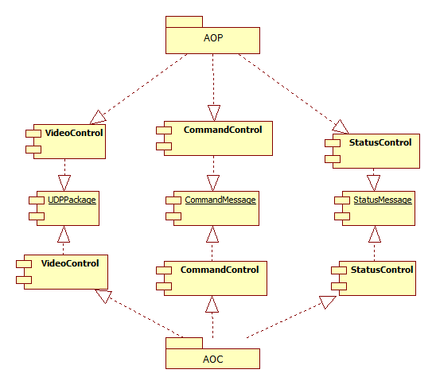
Software study
Hard & Soft
Component diagram

Slide 30
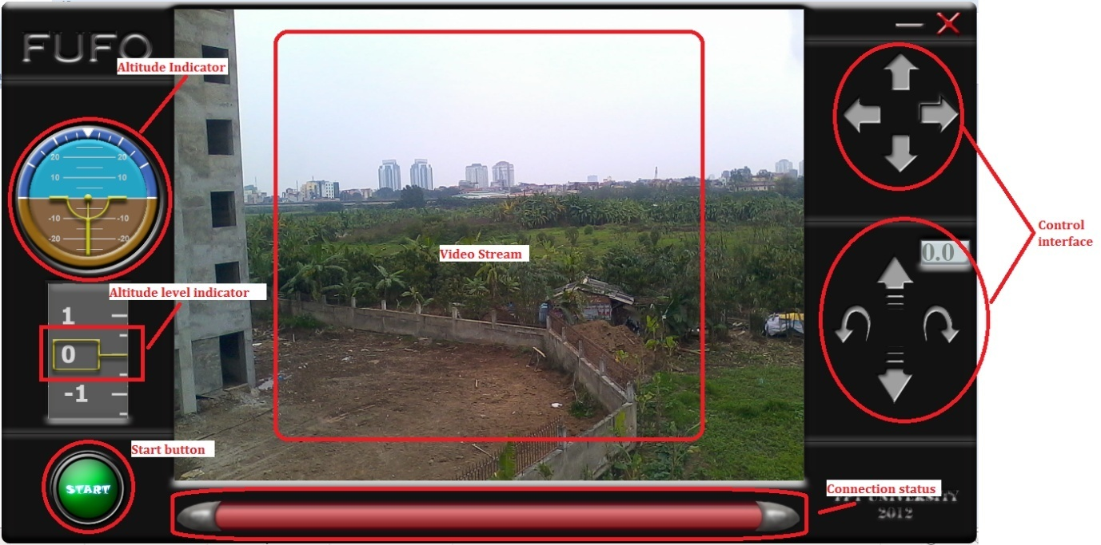
Software study
Hard & Soft
PC interface:

Slide 31
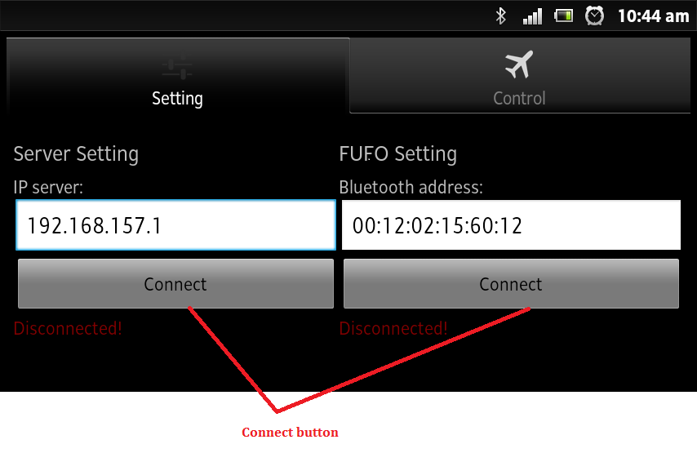
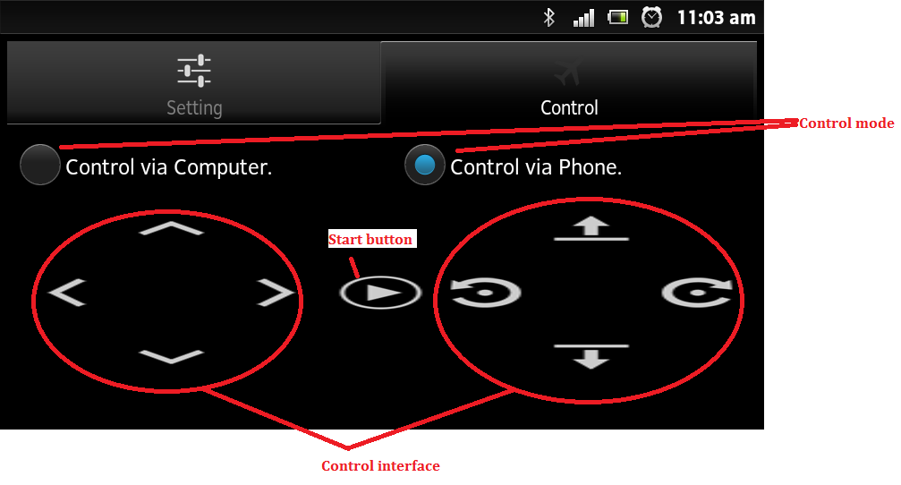
Software study
Hard & Soft
Android interface:

Slide 32
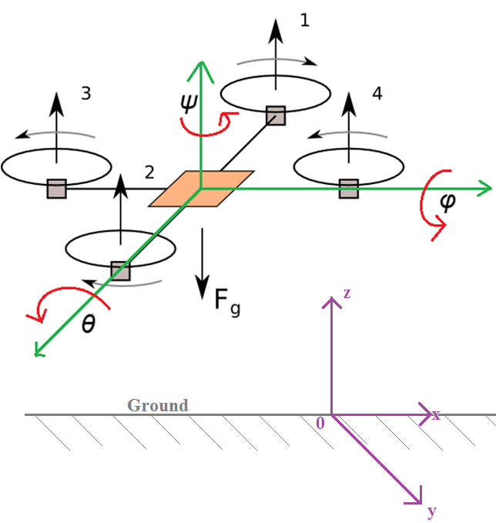
Quadrocopter Dynamic
Algorithms
𝜃, 𝜑, 𝜓 angles: describe the orientation of a rigid body.
z: altitude
of body
compare to
earth surface.

Slide 33
Quadrocopter Dynamic
Algorithms
Take the following variables into account:
𝜂₁ = [0,0,z];
𝜂₂ = [𝜃,𝜑,𝜓];
Derived force of each motor and the whole body.
Explain the following behaviors:
Linear translational movement.
Rotational movement.
<FUFO Final report, page 26 → 33>
⬅ No x, y positions

Slide 34
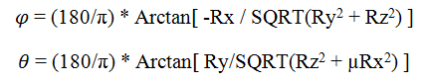
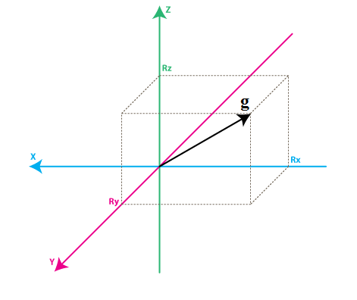
Signal Processing
Algorithms
Rotation angular calculation:
Accelerometer: Multiplication with a (x, y, z) Direction Cosine Transformation Matrix.
Notes:
Accel khá chính xác, nên nếu dùng số liệu theo cách tức thời như này thì sai số sẽ nhỏ.

Slide 35
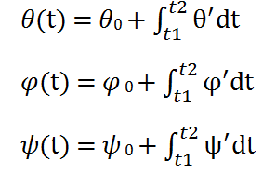
Signal Processing
Algorithms
Gyroscope: Integration of angular velocity over time.
Error over long period of time because of error accumulation.
Notes:
Gyro khá chính xác, nhưng nếu cộng dồn lại thì sai số sẽ tăng dần theo thời gian.

Slide 36
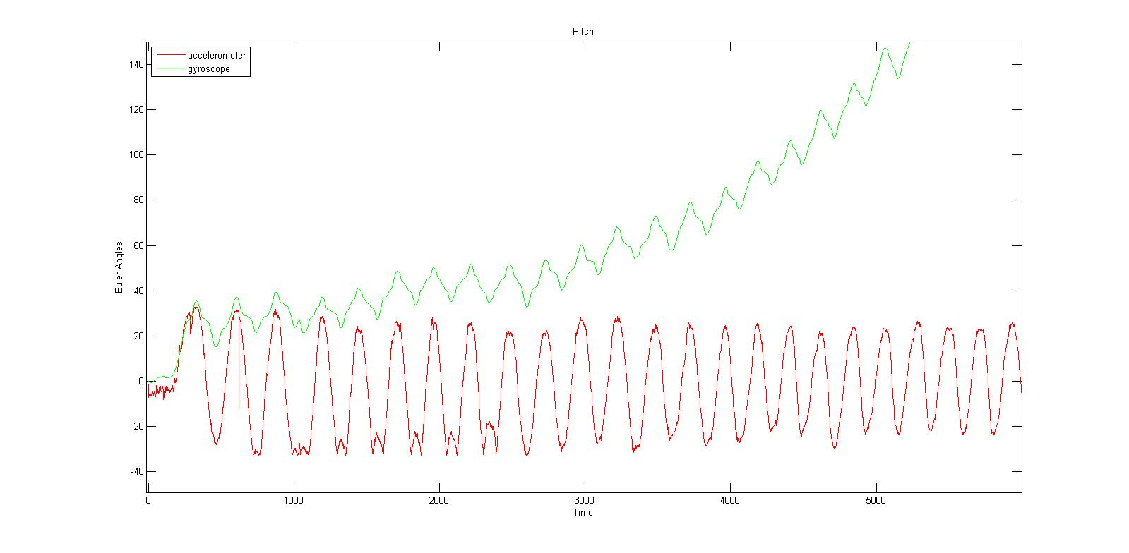
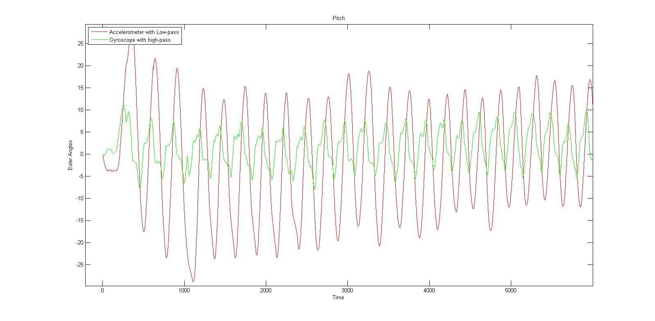
Signal Processing
Algorithms
Theta angle by Accelerometer and Gyroscope:
AFTER HIGH-PASS GYROS AND LOW-PASS ACCEL
BEFORE FILTER

Slide 37
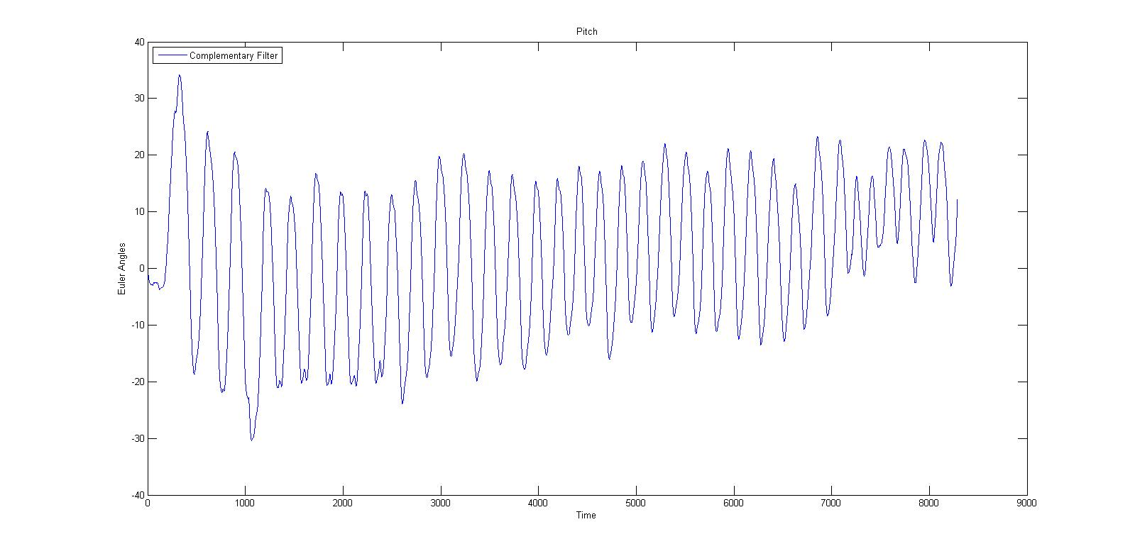
Signal Processing
Algorithms
Theta angle by Accelerometer and Gyroscope:
Data = p*𝜃accel + (1-p)*𝜃gyros
AFTER COMPLEMENTARY FILTER

Slide 38
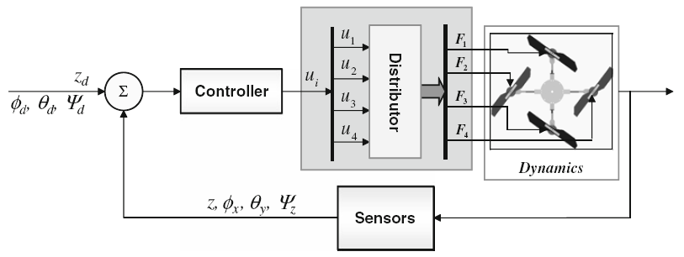
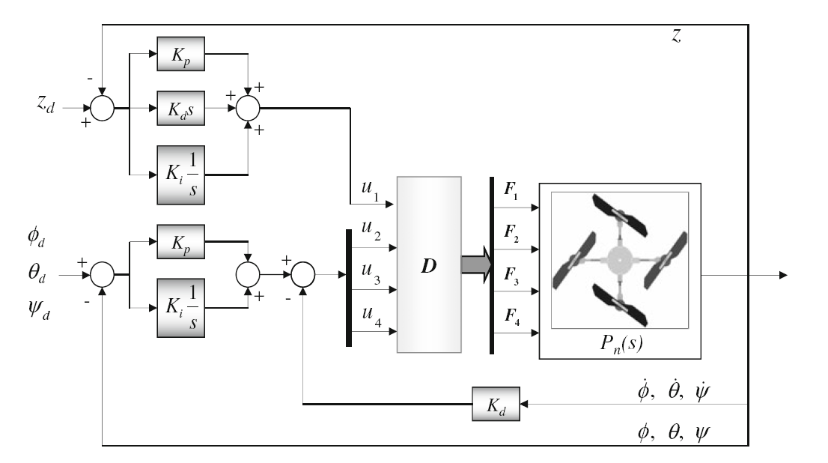
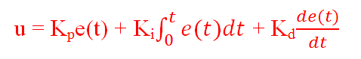
PID Control system
Algorithms
Close-loop feedback controller:
Notes:
U1, u2, u3, u4 là tham số điều khiển.

Slide 39
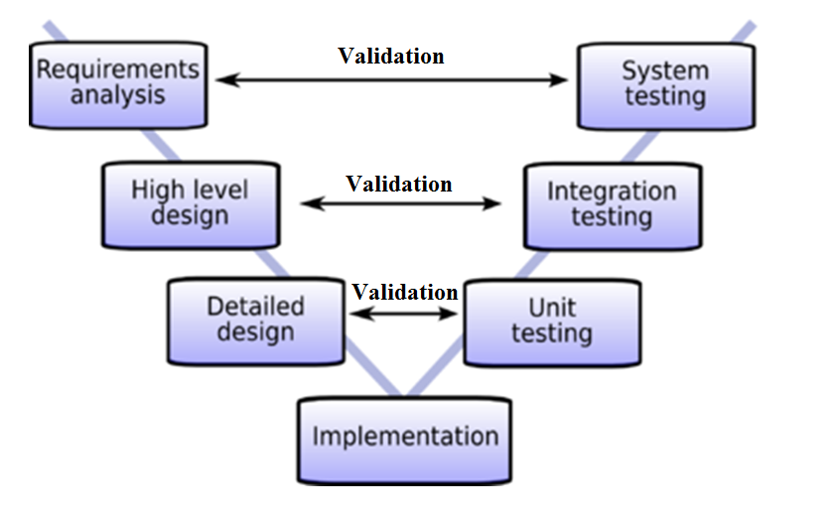
Result
Experiment
Test
Strategy

Slide 40
Result
Experiment
Function | Unit test |  |  |  | Integration test |  |  |  | System test
 | Test case |  | Bug |  | Test case |  | Bug |  | Test case |  | Bug |  | Result
 | Plan | Actual | Plan | Actual | Plan | Actual | Plan | Actual | Plan | Actual | Plan | Actual
AOP | 55 | 58 | 8 | 9 | 40 | 53 | 6 | 6 | 15 | 17 | 3 | 3 | OK
FUFO | 20 | 25 | 3 | 4 | 16 | 27 | 2 | 3 | 5 | 6 | 1 | 1 | OK
AOC | 45 | 48 | 7 | 7 | 36 | 38 | 5 | 5 | 12 | 13 | 2 | 2 | OK

Slide 41
Result
Experiment
UT+IT+ST | UT+IT+ST
Total Test case Actual | Total bug Actual
128 | 18
58 | 8
99 | 14

Slide 42
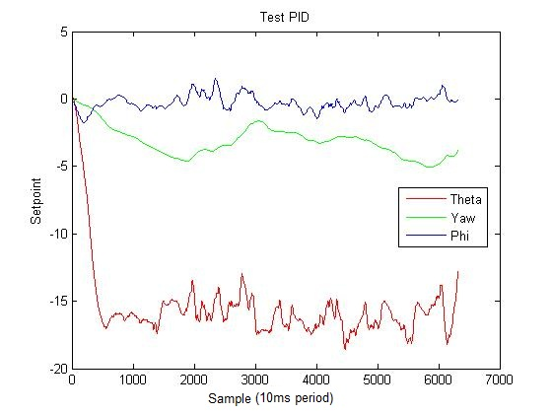
Results
Experiment
Indoor flight:

Slide 43
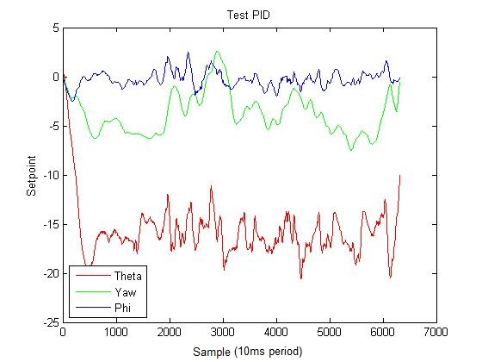
Results
Experiment
Outdoor flight:

Slide 44
Results
Experiment
Video

Slide 45
Achievement
Conclusion
Successfully proved the correctness of the aforementioned algorithms.
Understand more about this flying platform for further improvement and development.

Slide 46
Future Improvement
Conclusion
Develop a higher response system.
Hold altitude in narrow and low area with precision of +-0.1 m
Hold a specified position on map or moving on a track.
Obstacle detection and avoidance.
CMOS camera's video transmission over long distance.
Object detection based on image processing.

Slide 47

www.themegallery.com
Thank You !
From FUFO team with love

